Slide 1
Bridging Classical Neural Network with Quantum Neural Network
Prentatation by Meheru Jannat, Mahamudul Islam Shawcha

Slide 2
Introduction
Quantm Neural Networks(QNNS) are advantageous in tasks like image classification, but suffer from qubit instability and resource limitations.
This paper address this chalanges by using knowledge distillation to transfer knowledge from classical CNNs to Quantum Models, improving performace without extensive quantum model traning

Slide 3
Related Works
The research is grounded in Quantum Machine Learning (QML), Error Mitigation and Transfer Learning in QML.
Prior work lacks focus on classical-to-quantum transfer. This paper innovates by bridging the gap using knowledge distillation

Slide 4
Quantum Machine Learning(QML)
In theory : QML leverages quantum phenomena such as superposition and entanglement to speed up computations.
In this paper we explore QNN architectures that, when coupled with knowledge transfer from classical models, significantly reduce the need of training quantum models from scratch, especially on image classification tasks like MNIST

Slide 5
Error Mitigation and Resource handling
Quantum Models face challenges from quantum noise and qubi instability, requiring error correction techniques
By using classical CNNs as teacher model in knowledge distillation, we bypass the need for complex error-mitigation techniques, allowing quantum models to learn from classical output rather than raw quantum data.

Slide 6
Transfer Learning in Quantum Machine Learning
Transfer learning is used to transfer knowledge between models.
We propose classical-to-quantum transfer, where classical CNNs act as teachers, transferring their knowledge to quantum student models via knowledge distillation. This method alleviates the computational burden of quantum-only training.

Slide 7
Methodology
In the paper methodlogy is broken down into
Problem Formulation: How we strcture the classical-to-quantum transfer
Knowledge Distillation : The core of the teachnique used for training quantum models.
Quantum Superposition and Gradient Descent: Mathmatical foundation for the QNNs.

Slide 8
Problem formulation and integration of knowledge distillation
The problem we address is how to use classical models(LetNet ,AlexNet) to transfer learned knowledge to quantum models, improving their performance without quantum-only training. we apply KL-divergence to quantify the similarity between classical and quantum models during traning.

Slide 9
Knowledge Distillation
Knowledge distillation is a technique where a teacher model transfer knowledge to a student model
Classical CNNS serve as the teacher network, while quantum models are the student. The student QNN learns by mimicking the outputs of the classical CNN through response-based , feature-based, and relation-based distillation methods. This allows the quantum model to leverage classical knowledge without heavy training

Slide 10
Quantum Superposition and Mathmatical Intuition Behind QNNs
Quantum superposition allows a quantum system to exist in multiple states simultaneously
We use quantum circuits to encode data into superposed quantum states, increasing the parallelism of computations . This allows the quantum models to process input data more efficiently when paired with classical knowledge distillation

Slide 11
Quantum Gradient Descent and Parameter Optimization
Gradient Descent is used for optimization in machine learning models
We utilize Quantum Gradient Descent(QGD), specifically through the parameter shift rule, to update quantum models parametrs. By combining QGD with knowledge distillation , the quantum model is optimized to minimize the KL-divergence from the classical teacher model’s output.

Slide 12
Amplitude Encoding in Quantum Neural Network
Amplitude encoding compresses classical data into quantum states efficiently representing high-dimensional data
Amplitude encoding is applied to MNIST and FashionMNIST datasets, converting them into quantum states. This allows the QNNs to learn from the encode data and apply knowledge ditilled from classical models

Slide 13
Dataset Used
MNIST
A dataset of handwritten digits commonly used for traning classical models
2. FashionMNIST
A more complex dataset of clothing items used to test model generalization
Both datasets are used to evaluate the performance of quantum models with and without knowledge distillation from classical CNNs.

Slide 14
Dataset Filtering
We Preprocess the datasets using techniques like normalization filtering and resizing to ensure compatibility with both classical and quantum models. For QNNs, the data is further encoded into quantum states using amplitude encoding

Slide 15
Classical Convolutional Neural Networks(CNNs)
LetNet : A simple ,efficient architecture for digit classification
AlexNet : A deeper network that captures complex image features
Both LetNet and AlexNet are used as teacher models in ditillation process, providing the quantum student model with pre-trained knowledge on both MNIST and FashionMNIST datasets

Slide 16
Ensemble of AlexNet and Letnet
We combine the outputs of AlexNet and Letnet using an ensemble technique. The ensemble acts as a more robust teacher model, providing diverse representation of the data to improve the quantum student models’s performance

Slide 17
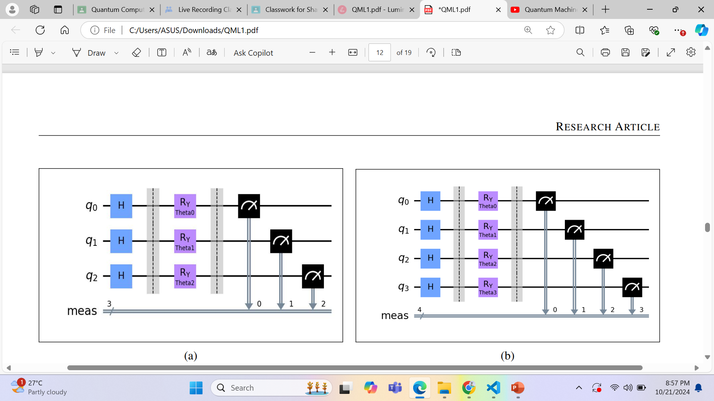
Parameterized Quantum Circuits
We employed two Parameterized Quantum Circuits (PQCs) with 3 and 4 qubits. PQCs, key in quantum machine learning and variational algorithms, adjust gate parameters (θ) to minimize a cost function. The 3-qubit PQC uses Hadamard (H) and parameterized rotation gates (R_Y), with angles θ optimized during learning. This circuit offers a compact, expressive model for smaller-scale tasks. The 4-qubit PQC, with an extra qubit, uses a sequence of R_Y gates and can capture more complex patterns due to the larger state space.

Slide 18
Performance Metrics
Accuracy = Number of correct predictions / Total number of predictions .
To evaluate our models, we use accuracy as the primary metric, which is suitable for the balanced datasets we crafted. Accuracy is calculated as the ratio of correct predictions to total predictions. In balanced datasets, it reliably reflects the model's classification performance. While other metrics like precision or recall are better for imbalanced datasets, accuracy is simple, interpretable, and computationally efficient, making it ideal for this study.

Slide 19
Implementation Details
Frameworks: PyTorch for neural networks, Qiskit QASM Simulator for quantum simulations.
Hyperparameter Optimization: Used to find optimal values for optimizer, learning rate,
loss function, KL-Divergence temperature, and λ.
Optimizer: Adam, chosen for handling noisy problems and sparse gradients.
Learning Rate & Training: Set to 0.001, with 10 epochs to avoid overfitting.
Loss Functions: Cross-Entropy Loss for classification, KL-Divergence
with temperature of 3 for knowledge distillation.
λ Value: 0.9, to appropriately balance the distillation loss in the overall loss function.
Quantum Experiments: 5000 shots per measurement for accurate probability distributions

